Slide 1
Dumbstruck Gold
Tristan Canova, Hamza Memon,
Emmanuel Rosario, Grant Boughton, Wyatt Sawyer

Slide 2
Dumbstruck’s API
Need an API Key
Get JSON data back

Slide 3
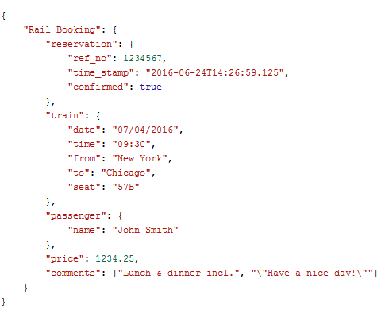
JSON

Slide 4

WebRTC
Web Real Time Communication
Before WebRTC
How we will use it
http://mdn-samples.mozilla.org/s/webrtc-capturestill/
https://test-developers.dumbstruck.com/api

Slide 5

Data-Driven Documents (D3)
Visualize data
Provides effective tools to manipulate documents based on data
Notes:
Hamza, please remove last link and send to cotler

Slide 6
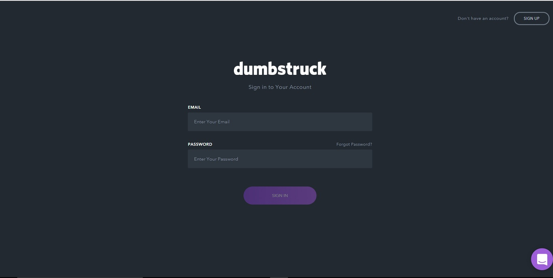
PRESENTATION MATERIAL ASSIGNMENTS

Slide 7
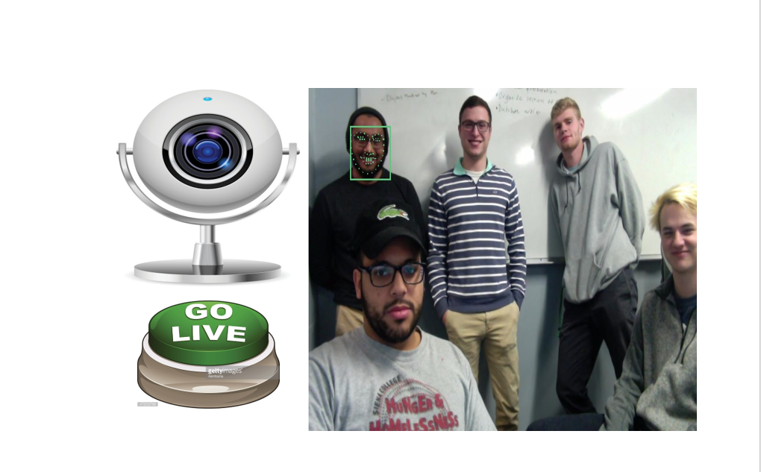

Slide 8
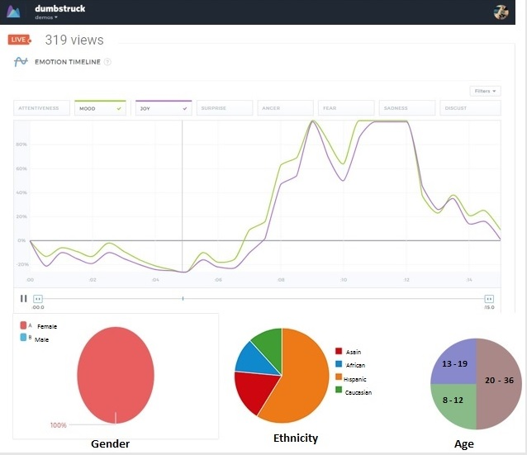

Slide 9
Lessons Learned
Utilization of tools
GitHub, Zenhub, slack etc
More planning and thorough communication
Understanding what is required, due dates, goals etc
Feedback and Adjustments
Update story point weights, create better stories, more stories of smaller weight

Slide 10
Thank You
Special Thanks to our clients!

Slide 11
Questions ???

